Slide 1
C++ Variables

Slide 2
Variables Naming Rules
variable name cannot be a keyword of C++
variable name cannot being with a digit
variable name may use letters, digits, or underscores
define: illegal
variable1: legal
variable_2: legal
2product: illegal
product#price: illegal
product-price: illegal

Slide 3
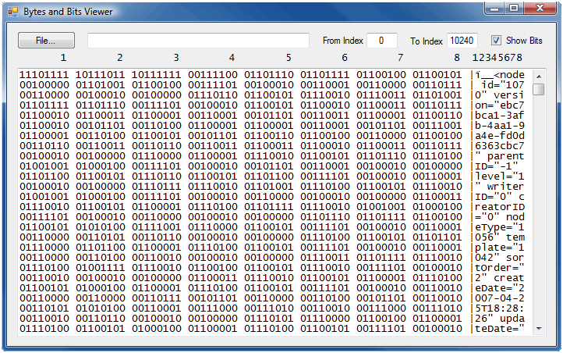
Variable Size
bit: value of 0 or 1
byte: storage space composed of 8 bits

Slide 4
Variable size (2)
short: 2 bytes, range: -32,768 to 32,768
int: 4 bytes, range: -2,147,483,468 to 2,147,483,468
unsigned short: 0 to 65535
double: 8 bytes
sizeof(type): returns the size of type

Slide 5
Characters and strings
char: store one character, size: 1byte
string: store a string value, size: at least 2 bytes
char x;
string y;
x=‘a’;
y=“b”;
We use the ascii code to store characters
A:65, B:66
2) <string>: header file to manipulate string variables

Slide 6
Integer/Decimal Numbers
short, int, long: integer numbers
float, double: decimal numbers
E notation: 24E4 equivalent to 24*10^4=240000
x=42.2f: forces 42.2 to be saved as a float number
x=42.2L: forces 42.2 to be saved as a decimal number

Slide 7
Boolean
boolean variable: true, false
bool: type of boolean variables
bool x,y;
x=true;
y=0;

Slide 8
Arithmetic Operations
+ : addition
- : subtraction
* : multiplication
/ : division
% modulus: remainder of a division
-: unary negation
* / %
+ -

Slide 9
literals, variables, constants
literal: value saved/used while coding
constant: variable whose value cannot be changed during the execution of the porgram
#define PI 3.14
const float PI=3.4;

Slide 10
Formatting decimal number:
1) Decimal number with n digits:
a) Use setprecision(n)
b) Example: cout << setprecision(4) << x;
2) Decimal number where the fractional contains n digits:
a) Use setiosflags(ios::fixed) << setprecision(n)
b) Example: cout << setiosflags(ios::fixed) << setprecision(5)<< x;
3) Format the integer part (00001):
a) Use setfill(‘0’)<<setw(n)
b) Example: setfill('0') << setw(4)<< x;

Slide 11
Formatting Text
1) Justify to the right:
a) Use setw(n)
b) Example: cout << setw(8) << x;
2) Justify to the left:
a) Use left
b) Example: cout << left << setw(4) << x;

